Slide 1
RFID Field strength Measurement Tag
Tijmen Verhulsdonck, Dhananjay Kittur, Binayak Ghosh

Slide 2
Goal of this project
To create an integrated wireless solution
To measure Field Strength of an RFID reader antenna
Present the data in a 3D graph

Slide 3
Description
RFID reader used to power the antenna and generate a field
A start signal is sent to the microcontroller to start sampling the voltages via AM modulation
3D tag, connected to microcontroller, used to read voltage values on three axes
Microcontroller reads and processes the measured voltage values
The 3D RF field measurement is plotted to represent the data in four dimension scattered graph (x,y,z,mmf)

Slide 4
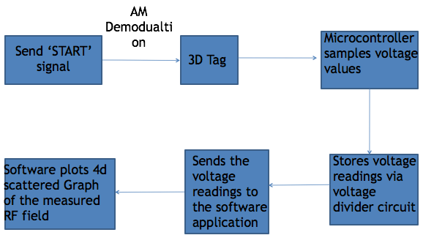
Block Diagram
ISO15693
Serial

Slide 5
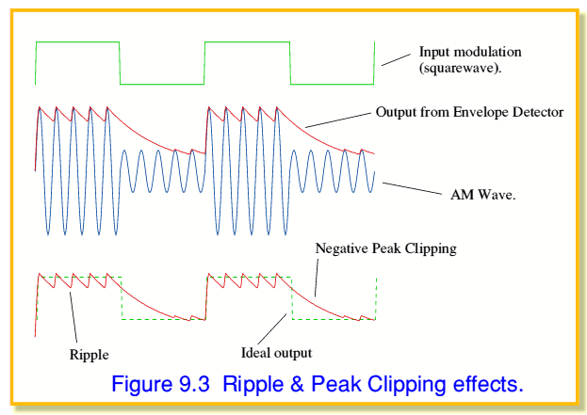
AM Demodulation
source:https://www.st-andrews.ac.uk/~www_pa/Scots_Guide/RadCom/part9/page2.html

Slide 6
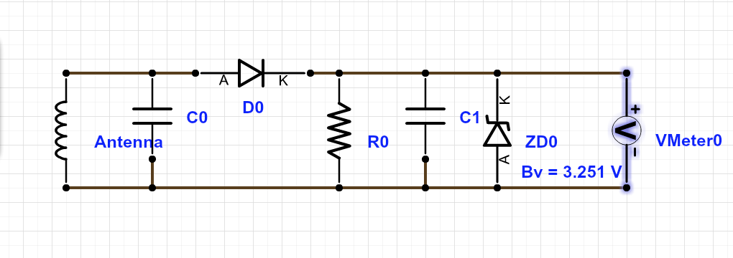
Envelope detector

Slide 7
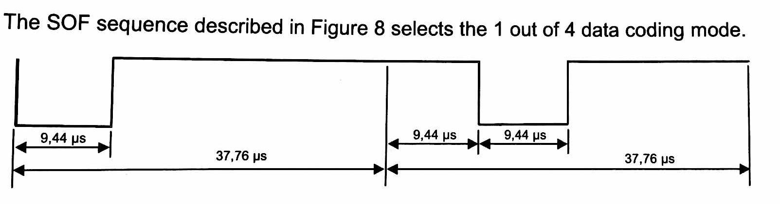
Start of frame Detection
Hardware Interrupt
Micro Seconds Timer

Slide 8
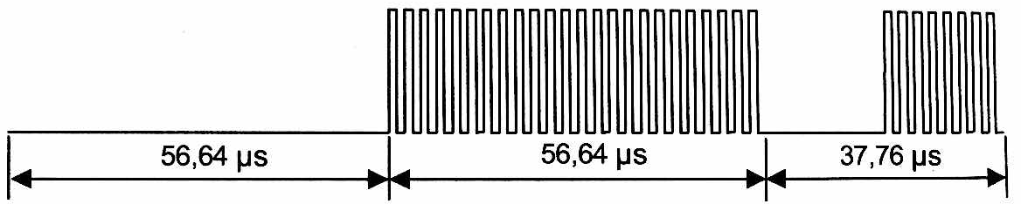
Frequency Modulation
Single Side Band
Passive Modulation
freq = 432.75 = fc/32

Slide 9
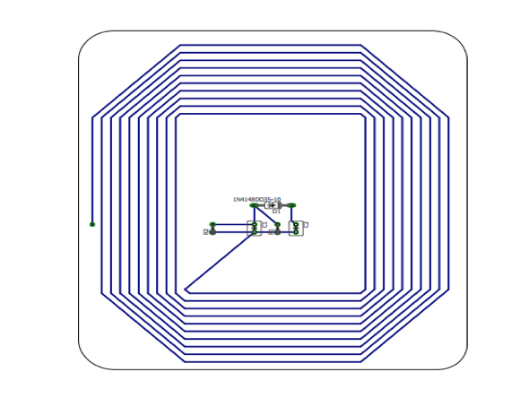
3D Tag
3 Seperate antenna’s oriented in the XYZ plane
PCB Based Antenna

Slide 10
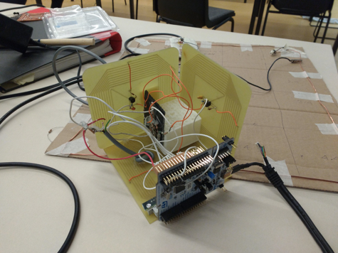
Three Dimensional Tag

Slide 11
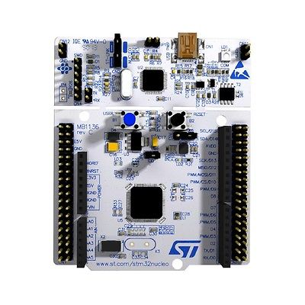
Microcontroller Circuit Nucleo STM32L476RG
A2,A3,A4-Voltmeter
A5-AM Mod

Slide 12


Voltage Divider Circuit
A2
R1
R2
10 samples per channel per location
V_XY
A3
avg over 100ms
R1
R2
V_YZ
A4
R1
R2
V_ZX

Slide 13
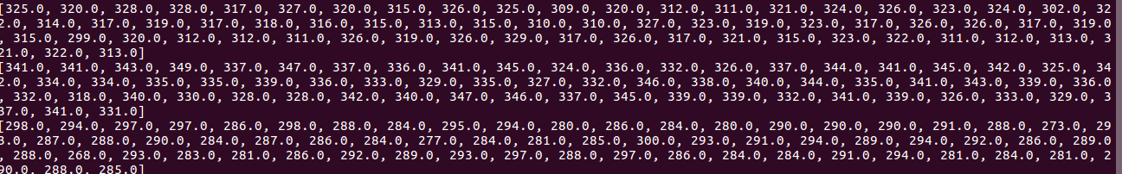
Sampled Voltage Readings

Slide 14
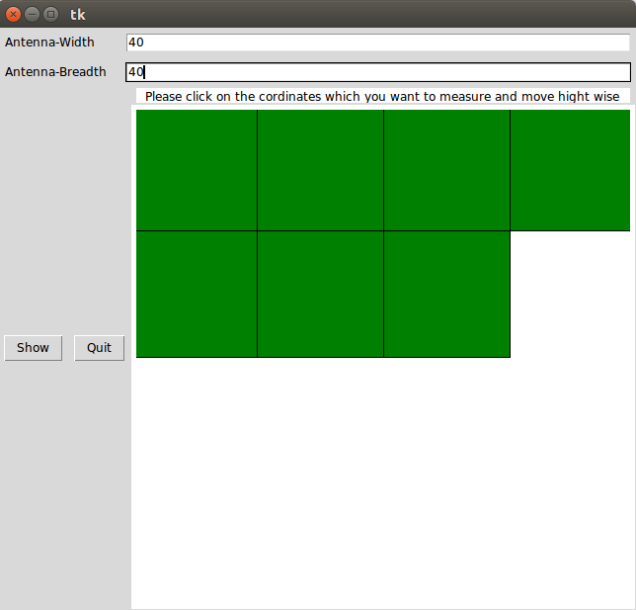
Graphical User Interface

Slide 15
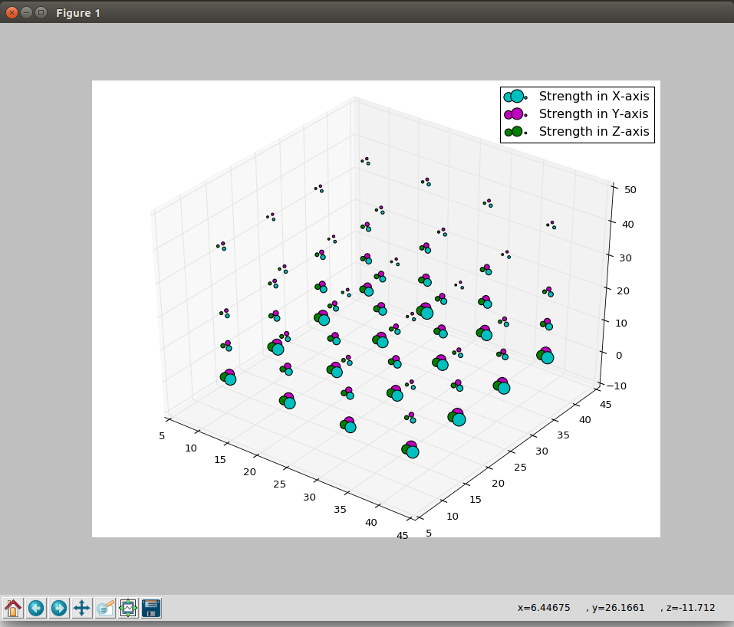
4-Dimensional Scattered Graph

Slide 16
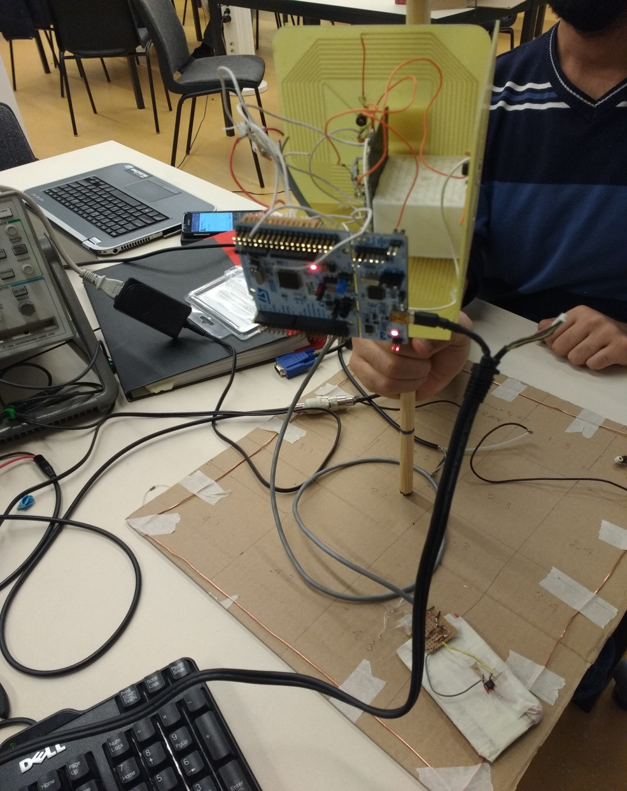
Semi Final Prototype

Slide 17
Problems encountered
Implementing the frequency modulation for transferring of the data proved to be quite complicated and time consuming
Input filtering resulting in:
Problems related to the micro-controller board towards the final stages of the project(over voltage)
The AM demodulation to decipher the start of frame signal was implemented initially, but there we faced some problem related to the timing

Slide 18
Any Questions?

